Slide 1
Describing Variable Distributions
R. Garner, DePaul University

Slide 2
Representing the distribution of a variable
How many cases are there at each value of the variable?
What is the frequency of cases for each value of the variable?
How can we represent this with graphs?
Are there summary measures we can use to “sum up” the distribution?
Its central tendency? Its variability?

Slide 3
Techniques to use
Graphing:
Bar charts
Histograms
Boxplots
Summary Measures:
Central Tendency and Variability (AKA spread, dispersion)

Slide 4
How to select a technique
All of these techniques of describing the distribution of a variable require checking whether it is NUMERICAL or CATEGORICAL (ordinal or nominal)
Numerical means that the numbers we see for the values associated with cases are real quantities.
Categorical means that the values of the variable are named “pigeonholes”—any numbers we see are just code numbers.

Slide 5
Graphing a variable distribution
The best way to graph a categorical variable is to make a bar chart. The height of the bars represents the frequencies for values of the variable. The frequencies might be counts or proportions (percentages) of the total cases.
A numerical variable is usually graphed with a histogram. The bars are “smooshed against each other” and the height of the bars represents the frequencies for the values of the variable.

Slide 6
The boxplot
A boxplot can be used for graphing the distribution of a numerical variable.
The vertical dimension (marked on the left-hand side of the graph) shows the range of values.
The boxplot indicates the cumulative percentages for the range of values of the variable. What are the values of the variable at which the 25th %, 50th % (median) and 75th % cases of the distribution fall? Which values are outliers or extreme values?

Slide 7
Numerical but discrete
If the values are numbers that correspond to real values (not code numbers), but they are discrete and whole numbers for small values in a relatively small range, we might use a bar chart.
How many pets do you own? How many points did the soccer team score in each game of the season?

Slide 8
Measures of central tendency
These are measures describing the middle, central, or “average” of a variable distribution.
The mean can be calculated ONLY for numerical variables.
The median can be calculated for numerical and ordinal variables.
The mode is the only one that can be used for nominal variables; it can be used for ordinal and numerical data as well.

Slide 9
Calculation of the (arithmetic) mean
Add all the observed values of the variable (one value for each case).
Add them all.
Divide by the number of cases.
It is the sum of all the observations (values that appear in the observed distribution) divided by the number of observations.
The resulting number represents how much each case would get if the observed values were distributed equally.
The mean is said to be “unbiased” because every value for every case in the distribution was included in the calculation.

Slide 10
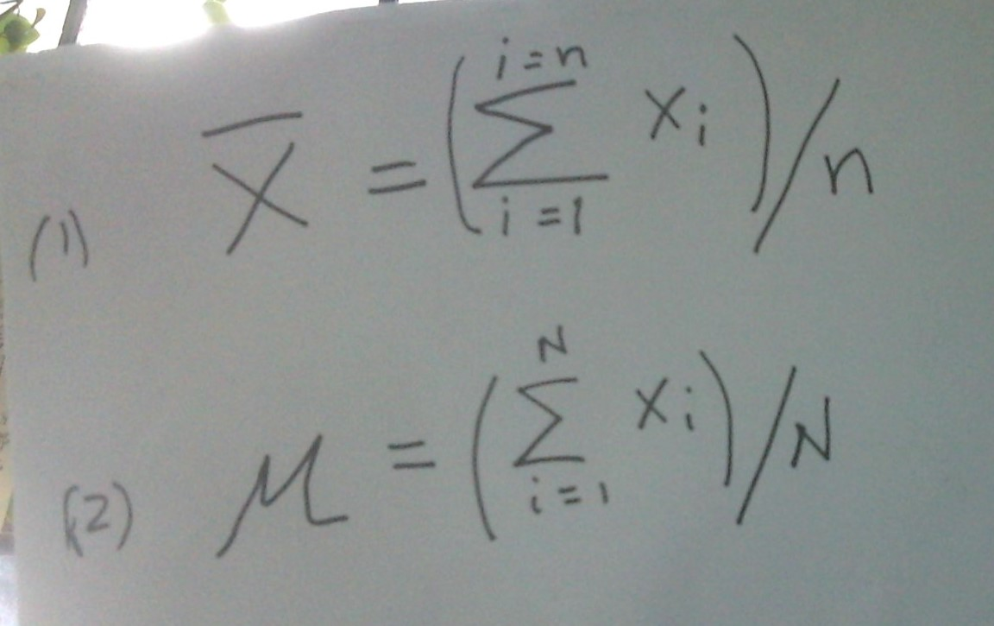
The formula for the mean

Slide 11
Formula for the mean - explained
Formula (1) is for sample data, designated as an X with a bar over it.
Formula (2) is for a population, designated with the Greek letter lower-case mu, μ.
The actual calculations are identical.
The Greek capital sigma, Σ, is the “Addition Operator” and tells us to add up what follows—in this case, all the observations, each one designated by a subscripted x, from 1 to N (or n, if we think of the observations as sample data).

Slide 12
The median
Line up all the values for all the cases in ascending order. (You can do this if the values are numerical or ordinal.)
If the number of cases is odd, find the value associated with the middle case of this line-up. (The value of the variable for the case at the 50th percentile.)
If the number of cases is even, find the values associated with the two middle cases and find their arithmetic mean.

Slide 13
The mode
The mode can be found for nominal and ordinal data, as well as numerical data.
The mode is the value of the variable with the highest frequency—the one that shows up most often in the distribution.
The modal frequency is the number of cases that are associated with this value.

Slide 14
The mode (continued)
Remember, the mode can be found for ordinal and nominal data, and then the mode is a named category; the modal frequency is how many cases are associated with the category.
What was the most frequent student rating for this instructor? Very good.
How many students gave her this rating? 65 out of 100 students (that is the modal frequency)
What was the sample’s favorite soft drink? Mountain Dew. 188 out of 200 preferred it!

Slide 15
Measures of variability
These are summary ways of describing how variable, dispersed, or spread a distribution is. Is the distribution tightly clustered or “congregated” around its mean, or is it spread out?
For a time sequence of observations, we can ask if the values are volatile—variable over time, now up and now down. For example, do prices of stocks or soap fluctuate a lot?

Slide 16
The range
One measure of variability for numerical variables is the range, found by subtracting the smallest value (minimum) in the distribution from the largest value (maximum).
This summary measure can be useful, but it does not tell us very much about how close the observations are to the mean. For example, all but two of them could be very close to the mean, but the maximum and minimum far away.

Slide 17
Standard deviation and variance
For numerical data, the most commonly used measures of variability are the standard deviation and the variance.
Look carefully at the next slide, with the formula for the population and sample standard deviation.

Slide 18
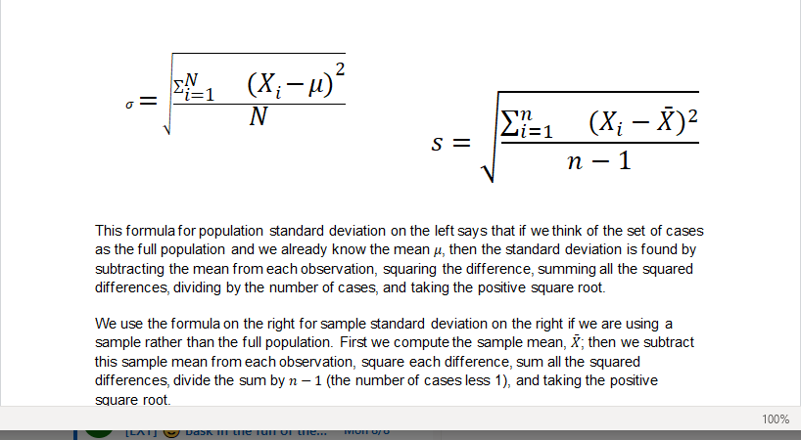
Formula for the standard deviation:

Slide 19
Standard deviation (continued)
The formulas for the standard deviation for a sample (s) and for a population (σ, called sigma—lower case!) are basically the same.
We subtract the mean from each observation, square the difference, add up the squares, and divide the sum of squares by the number of cases. If we are looking at sample data, we divide by (n -1).
Then we take the positive square root.

Slide 20
The variance
The variance is the number we got in the calculation of the standard deviation BEFORE we took the positive square root.
It is the mean of the sum of the squared deviations from the mean.

Slide 21
ALERT
Memorizing the formula for the standard deviation (and variance) is HIGHLY RECOMMENDED!

Slide 22
Index of diversity for categorical variables
An index of diversity can be calculated for categorical data, for a variable that measures diversity.
For example, how gender diverse is this graduating class of Air Force pilots?
How ethnically (or racially) diverse is this police department?
The index includes the number of categories and the evenness of distribution in the categories.

Slide 23
Algorithm for index of diversity (see the text for the formula)
Find the proportion of cases in each category of the variable (fraction or decimal fraction).
Square each proportion. This will give you one square for each category.
Add all the squares, one for each category (sum of squares).
Subtract the sum of the squared proportions from 1.

